Slide 1


BASIC CALCULATOR
Aakanksha Shewale

Slide 2
INTRODUCTION
Title: Extended Calculator with tkinter
Objective: Build a GUI-based calculator with additional functions: square, square root, cube, and backspace.
Language: Python
Library: tkinter

Slide 3
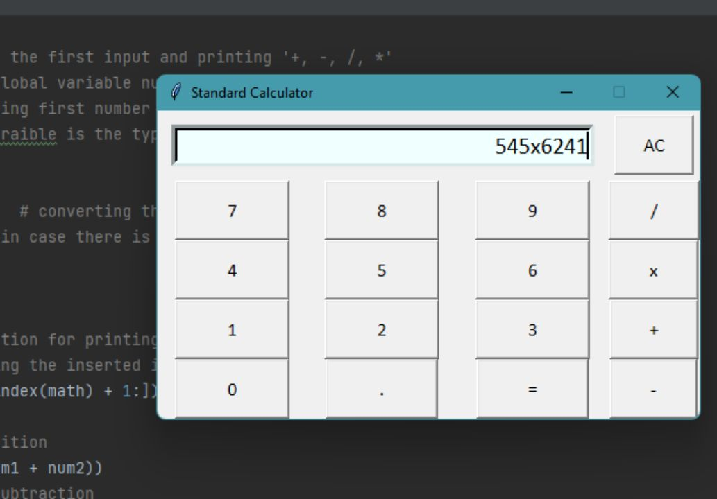
GUI Layout
GUI Components
Entry Field:
Displays current input and results.
Positioned at the top, spanning across multiple columns.
Buttons:
Digits: 0-9
Operators: +, -, *, /
Additional Functions: sqrt, ^2, ^3, <-
Special: C (Clear), = (Equals)

Slide 4
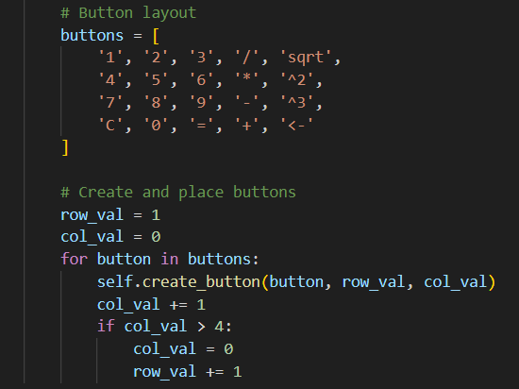
Button Configuration
Button Setup :
Creating Buttons:
Use tk.Button to create each button with text and size.
Arrange buttons in a grid layout using grid() method.
Button Actions:
Each button triggers on_button_click() method with its text as a parameter.

Slide 5
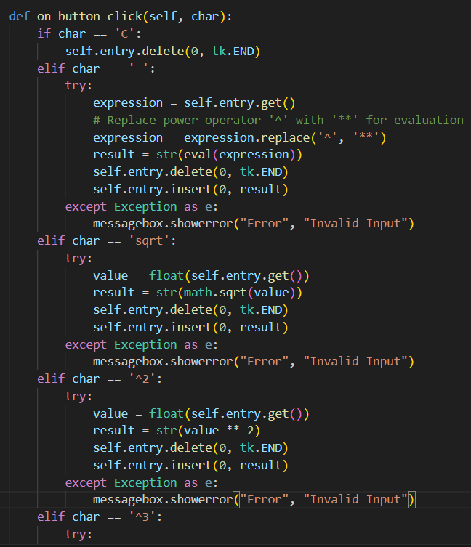
Functionality
Clear (C): Clears the entry field.
Equal (=): Evaluates the expression using eval(), replaces ^ with ** for exponentiation.
Square Root (sqrt): Computes the square root using math.sqrt().
Square (^2): Squares the number.
Cube (^3): Cubes the number.
Backspace (<-): Removes the last character from the entry field.
Default: Appends the clicked character to the entry field.

Slide 6
Execution and Usage
Running the Script:
Save the code in a file named extended_calculator.py.
Run the script using Python from the command line:
User Interaction:
Click buttons to input numbers, perform calculations, and use special functions.
Results and errors are displayed in the entry field.

Slide 7
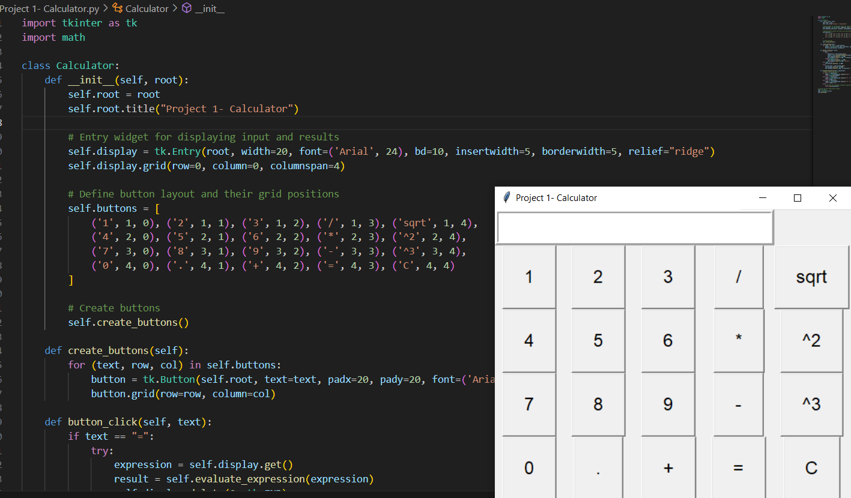
OUTPUT
Basic Arithmetic Operations:
Example Input: 2 + 3 Result: 5
Example Input: 7 * 6 Result: 42
Advanced Mathematical Operations:
Square Root Calculation:
Example Input: sqrt25 Result: 5.0
Example Input: sqrt16 Result: 4.0
Square Calculation:
Example Input: 5^2 Result: 25
Example Input: 4^2 Result: 16
Cube Calculation:
Example Input: 3^3 Result: 27
Example Input: 2^3 Result: 8

Slide 8
CONCLUSION
This advanced calculator project illustrates how to use Tkinter to create a versatile and interactive GUI application. By combining basic arithmetic with advanced mathematical operations, the calculator becomes a powerful tool for various calculations. The use of Tkinter provides a straightforward way to design and manage the user interface, making it accessible for both simple and complex mathematical tasks.

Slide 9




THANK YOU
Aakanksha Shewale
+91 9657756741
aakankshashewale@gmail.com

